Slide 1
Brain Computer Interaction
Feature Translation – Decision Trees
Course Instructors
Dr. Annushree Bablani
Acknowledgements: Dr. Sreeja S R

Slide 2
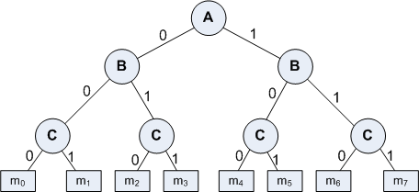
Basic Concept
A Decision Tree is an important data structure known to solve many computational problems
Example 8.1: Binary Decision Tree

Slide 3
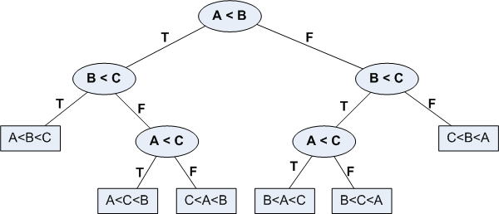
Basic Concept
In Example 18.1, we have considered a decision tree where values of any attribute if binary only. Decision tree is also possible where attributes are of continuous data type
Example 8.2: Decision Tree with numeric data

Slide 4
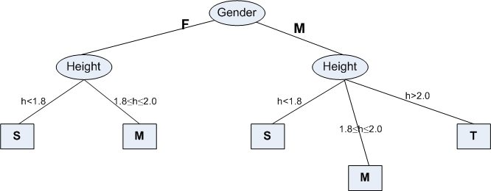
Some Characteristics
Decision tree may be n-ary, n ≥ 2.
There is a special node called root node.
All nodes drawn with circle (ellipse) are called internal nodes.
All nodes drawn with rectangle boxes are called terminal nodes or leaf nodes.
Edges of a node represent the outcome for a value of the node.
In a path, a node with same label is never repeated.
Decision tree is not unique, as different ordering of internal nodes can give different decision tree.

Slide 5
Decision Tree and Classification Task
Decision tree helps us to classify data.
Internal nodes are some attribute
Edges are the values of attributes
External nodes are the outcome of classification
Such a classification is, in fact, made by posing questions starting from the root node to each terminal node.

Slide 6
Decision Tree and Classification Task
Example 8.3 : Vertebrate Classification
What are the class label of Dragon and Shark?
Name | Body Temperature | Skin Cover | Gives Birth | Aquatic Creature | Aerial Creature | Has Legs | Hibernates | Class
Human | Warm | hair | yes | no | no | yes | no | Mammal
Python | Cold | scales | no | no | no | no | yes | Reptile
Salmon | Cold | scales | no | yes | no | no | no | Fish
Whale | Warm | hair | yes | yes | no | no | no | Mammal
Frog | Cold | none | no | semi | no | yes | yes | Amphibian
Komodo | Cold | scales | no | no | no | yes | no | Reptile
Bat | Warm | hair | yes | no | yes | yes | yes | Mammal
Pigeon | Warm | feathers | no | no | yes | yes | no | Bird
Cat | Warm | fur | yes | no | no | yes | no | Mammal
Leopard | Cold | scales | yes | yes | no | no | no | Fish
Turtle | Cold | scales | no | semi | no | yes | no | Reptile
Penguin | Warm | feathers | no | semi | no | yes | no | Bird
Porcupine | Warm | quills | yes | no | no | yes | yes | Mammal
Eel | Cold | scales | no | yes | no | no | no | Fish
Salamander | Cold | none | no | semi | no | yes | yes | Amphibian

Slide 7
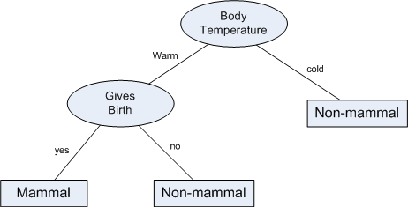
Decision Tree and Classification Task
Example 8.3 : Vertebrate Classification
Suppose, a new species is discovered as follows.
Decision Tree that can be inducted based on the data (in Example 8.3) is as follows.
Name | Body Temperature | Skin Cover | Gives Birth | Aquatic Creature | Aerial Creature | Has Legs | Hibernates | Class
Gila Monster | cold | scale | no | no | no | yes | yes | ?

Slide 8
Decision Tree and Classification Task
The above Example illustrates how we can solve a classification problem by asking a series of question about the attributes.
Each time we receive an answer, a follow-up question is asked until we reach a conclusion about the class-label of the test.
The series of questions and their answers can be organized in the form of a decision tree
As a hierarchical structure consisting of nodes and edges
Once a decision tree is built, it is applied to any test to classify it.

Slide 9
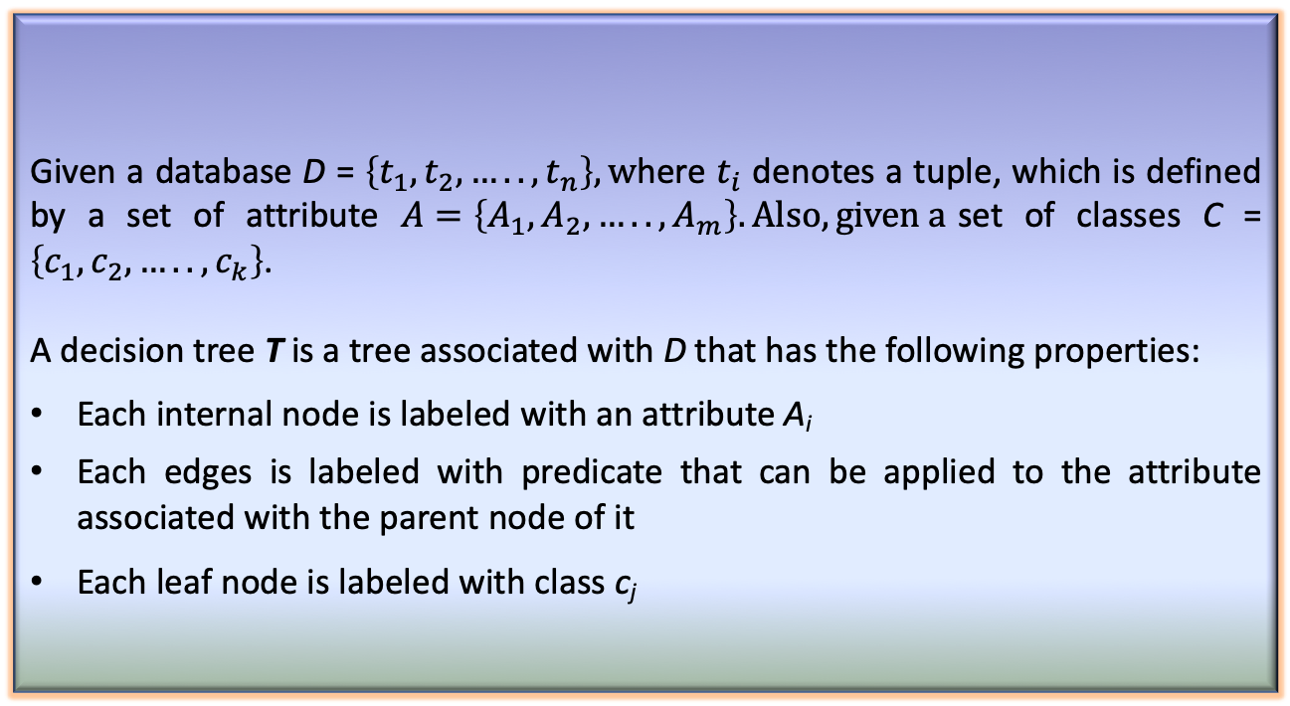
Definition of Decision Tree
Given a database D = $\left\{t_{1},t_{2},…..,t_{n}\right\}, w$here $t_{i}$ denotes a tuple, which is defined by a set of attribute $A=\left\{A_{1},A_{2},…..,A_{m}\right\}. Also, given a$set of classes C = $\left\{c_{1},c_{2},…..,c_{k}\right\}$.
A decision tree T is a tree associated with D that has the following properties:
Each internal node is labeled with an attribute A_{i}
Each edges is labeled with predicate that can be applied to the attribute associated with the parent node of it
Each leaf node is labeled with class c_{j}
Definition 1: Decision Tree

Slide 10
Building Decision Tree
In principle, there are exponentially many decision tree that can be constructed from a given database (also called training data).
Some of the tree may not be optimum
Some of them may give inaccurate result
Two approaches are known
Greedy strategy
A top-down recursive divide-and-conquer
Modification of greedy strategy
ID3
C4.5
CART, etc.

Slide 11
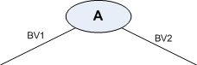
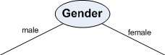
Node Splitting in BuildDT Algorithm
BuildDT algorithm must provides a method for expressing an attribute test condition and corresponding outcome for different attribute type
Case: Binary attribute
This is the simplest case of node splitting
The test condition for a binary attribute generates only two outcomes

Slide 12
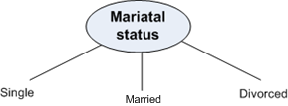
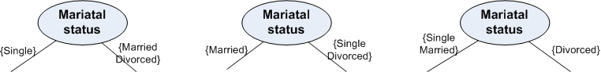
Node Splitting in BuildDT Algorithm
Case: Nominal attribute
Since a nominal attribute can have many values, its test condition can be expressed in two ways:
A multi-way split
A binary split
Muti-way split: Outcome depends on the number of distinct values for the corresponding attribute
Binary splitting by grouping attribute values

Slide 13
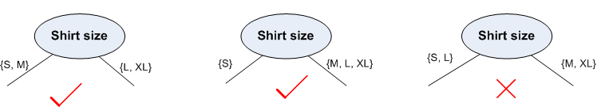
Node Splitting in BuildDT Algorithm
Case: Ordinal attribute
It also can be expressed in two ways:
A multi-way split
A binary split
Multi-way split: It is same as in the case of nominal attribute
Binary splitting attribute values should be grouped maintaining the order property of the attribute values

Slide 14
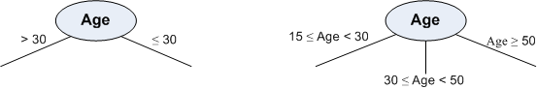
Node Splitting in BuildDT Algorithm
Case: Numerical attribute
For numeric attribute (with discrete or continuous values), a test condition can be expressed as a comparison set
Binary outcome: A > v or A ≤ v
In this case, decision tree induction must consider all possible split positions
Range query : v_{i} ≤ A < v_{i+1} for i = 1, 2, …, q (if q number of ranges are chosen)
Here, q should be decided a priori
For a numeric attribute, decision tree induction is a combinatorial optimization problem

Slide 15
Illustration : BuildDT Algorithm
Example 8.4: Illustration of BuildDT Algorithm
Consider a training data set as shown.
Attributes:
Gender = {Male(M), Female (F)} // Binary attribute
Height = {1.5, …, 2.5} // Continuous attribute
Class = {Short (S), Medium (M), Tall (T)}
Given a person, we are to test in which class s/he belongs

Slide 16
Illustration : BuildDT Algorithm
To built a decision tree, we can select an attribute in two different orderings: <Gender, Height> or <Height, Gender>
Further, for each ordering, we can choose different ways of splitting
Different instances are shown in the following.
Approach 1 : <Gender, Height>

Slide 17
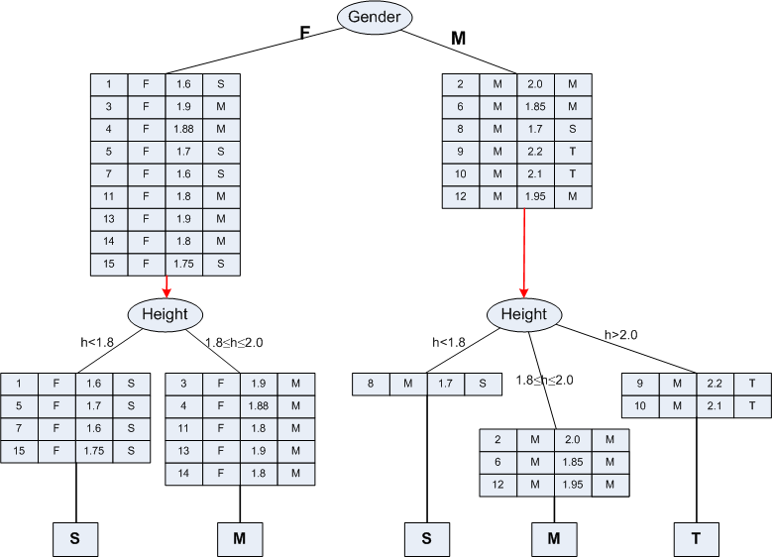
Illustration : BuildDT Algorithm

Slide 18
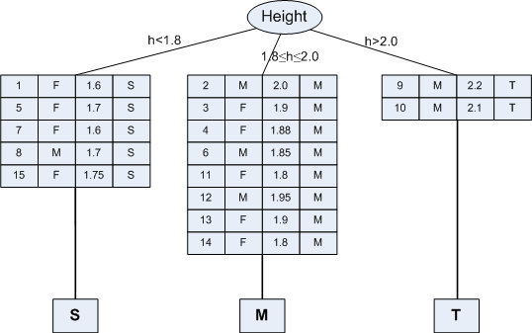
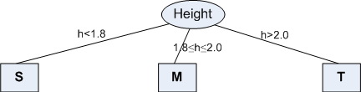
Illustration : BuildDT Algorithm
Approach 2 : <Height, Gender>

Slide 19
Illustration : BuildDT Algorithm
Example 8.5: Illustration of BuildDT Algorithm
Consider an anonymous database as shown.
Is there any “clue” that enables to select the “best” attribute first?
Suppose, following are two attempts:
A1→A2→A3→A4 [naïve]
A3→A2→A4→A1 [Random]
Draw the decision trees in the above-mentioned two cases.
Are the trees different to classify any test data?
If any other sample data is added into the database, is that likely to alter the decision tree already obtained?

Slide 20
Concept of Entropy

Slide 21
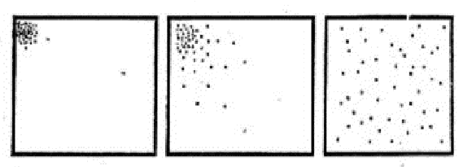
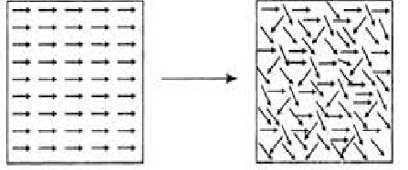
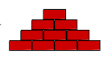

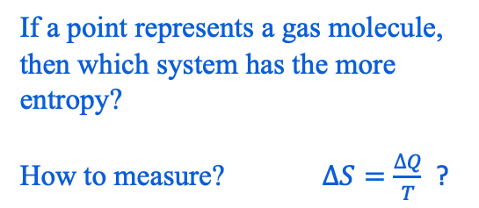
Concept of Entropy
If a point represents a gas molecule,
then which system has the more
entropy?
How to measure? $∆S=\frac{∆Q}{T}$ ?
More ordered Less ordered
less entropy higher entropy
More organized or Less organized or
ordered (less probable) disordered (more probable)

Slide 22
An Open Challenge!
Roll No. | Assignment | Project | Mid-Sem | End-Sem
12BT3FP06 | 89 | 99 | 56 | 91
10IM30013 | 95 | 98 | 55 | 93
12CE31005 | 98 | 96 | 58 | 97
12EC35015 | 93 | 95 | 54 | 99
12GG2005 | 90 | 91 | 53 | 98
12MI33006 | 91 | 93 | 57 | 97
13AG36001 | 96 | 94 | 58 | 95
13EE10009 | 92 | 96 | 56 | 96
13MA20012 | 88 | 98 | 59 | 96
14CS30017 | 94 | 90 | 60 | 94
14ME10067 | 90 | 92 | 58 | 95
14MT10038 | 99 | 89 | 55 | 93
Roll No. | Assignment | Project | Mid-Sem | End-Sem
12BT3FP06 | 19 | 59 | 16 | 71
10IM30013 | 37 | 38 | 25 | 83
12CE31005 | 38 | 16 | 48 | 97
12EC35015 | 23 | 95 | 54 | 19
12GG2005 | 40 | 71 | 43 | 28
12MI33006 | 61 | 93 | 47 | 97
13AG36001 | 26 | 64 | 48 | 75
13EE10009 | 92 | 46 | 56 | 56
13MA20012 | 88 | 58 | 59 | 66
14CS30017 | 74 | 20 | 60 | 44
14ME10067 | 50 | 42 | 38 | 35
14MT10038 | 29 | 69 | 25 | 33
Two sheets showing the tabulation of marks obtained in a course are shown.
Which tabulation of marks shows the “good” performance of the class?
How you can measure the same?

Slide 23
Entropy and its Meaning
Entropy is an important concept used in Physics in the context of heat and thereby uncertainty of the states of a matter.
At a later stage, with the growth of Information Technology, entropy becomes an important concept in Information Theory.
To deal with the classification job, entropy is an important concept, which is considered as
an information-theoretic measure of the “uncertainty” contained in a training data
due to the presence of more than one classes.

Slide 24
Entropy in Information Theory
The entropy concept in information theory first time coined by Claude Shannon (1850).
The first time it was used to measure the “information content” in messages.
According to his concept of entropy, presently entropy is widely being used as a way of representing messages for efficient transmission by Telecommunication Systems.

Slide 25
Measure of Information Content
People, in general, are information hungry!
Everybody wants to acquire information (from newspaper, library, nature, fellows, etc.)
Think how a crime detector do it to know about the crime from crime spot and criminal(s).
Kids annoyed their parents asking questions.
In fact, fundamental thing is that we gather information asking questions (and decision tree induction is no exception).
We may note that information gathering may be with certainty or uncertainty.

Slide 26
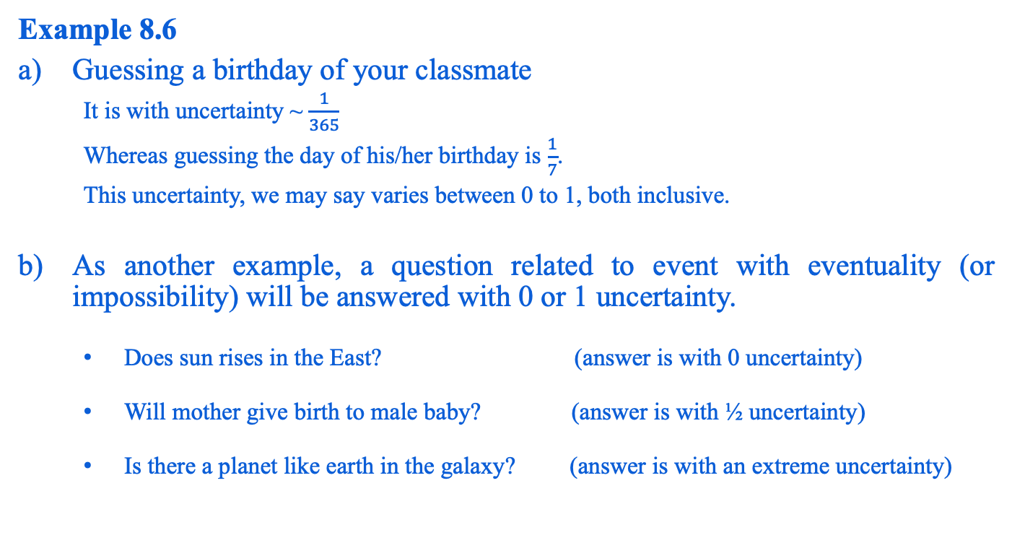
Measure of Information Content
Example 8.6
Guessing a birthday of your classmate
It is with uncertainty ~ $\frac{1}{365}$
Whereas guessing the day of his/her birthday is $\frac{1}{7}$.
This uncertainty, we may say varies between 0 to 1, both inclusive.
As another example, a question related to event with eventuality (or impossibility) will be answered with 0 or 1 uncertainty.
Does sun rises in the East? (answer is with 0 uncertainty)
Will mother give birth to male baby? (answer is with ½ uncertainty)
Is there a planet like earth in the galaxy? (answer is with an extreme uncertainty)

Slide 27
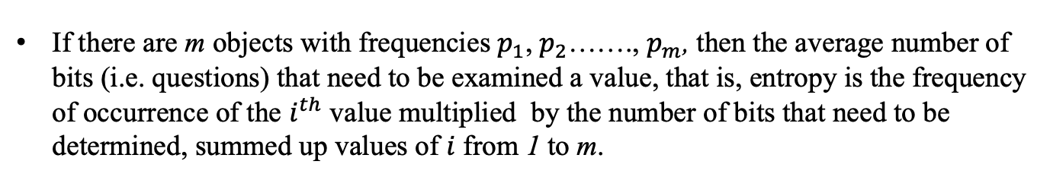
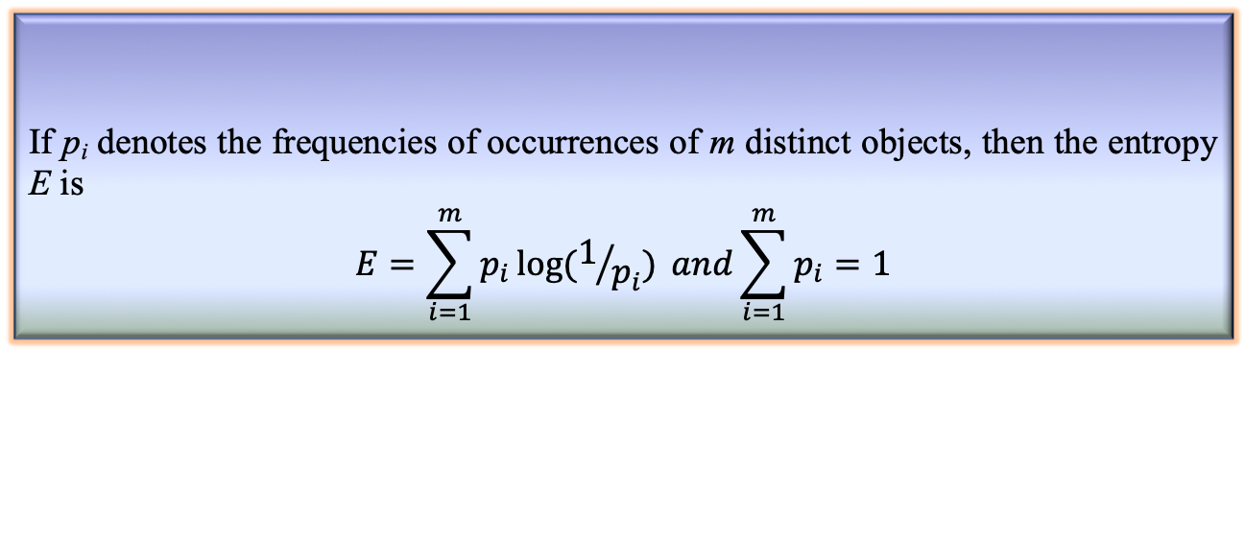
Entropy Calculation
If there are m objects with frequencies $p_{1}$, $p_{2}$……., $p_{m}$, then the average number of bits (i.e. questions) that need to be examined a value, that is, entropy is the frequency of occurrence of the $i^{th}$ value multiplied by the number of bits that need to be determined, summed up values of $i$ from 1 to m.
If p_{i} denotes the frequencies of occurrences of m distinct objects, then the entropy E is
$$E=\sum_{i=1}^{m}{p_{i}\log{(1/{p_{i}})}} and\sum_{i=1}^{m}{p_{i}=1}$$
Theorem: Entropy calculation
Note:
If all are equally likely, then $p_{i}=\frac{1}{m}$ and $E=\log_{2}{m}$; it is the special case.

Slide 28
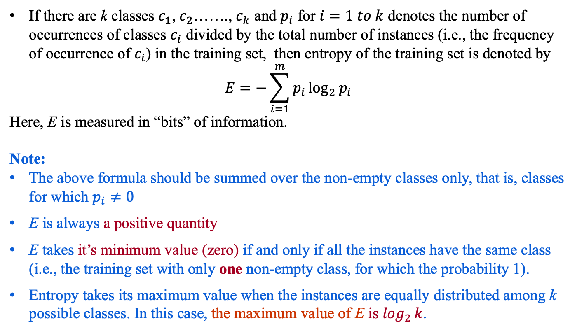
Entropy of a Training Set
If there are k classes $c_{1}$, $c_{2}$……., $c_{k}$ and $p_{i}$ for $i=1 to k$ denotes the number of occurrences of classes $c_{i}$ divided by the total number of instances (i.e., the frequency of occurrence of $c_{i}$) in the training set, then entropy of the training set is denoted by
$$E=−\sum_{i=1}^{m}{p_{i}}\log_{2}{p_{i}}$$
Here, E is measured in “bits” of information.
Note:
The above formula should be summed over the non-empty classes only, that is, classes for which $p_{i}≠0$
E is always a positive quantity
E takes it’s minimum value (zero) if and only if all the instances have the same class (i.e., the training set with only one non-empty class, for which the probability 1).
Entropy takes its maximum value when the instances are equally distributed among k possible classes. In this case, the maximum value of E is $\log_{2}{k}$.

Slide 29
Entropy of a Training Set
Example 18.10: OPTH dataset
Consider the OTPH data shown in the following table with total 24 instances in it.
Age | Eye sight | Astigmatic | Use Type | Class
1 1 1 1 1 1 | 1 1 1 1 2 2 | 1 1 2 2 1 1 | 1 2 1 2 1 2 | 3 2 3 1 3 2
1 1 2 2 2 2 | 2 2 1 1 1 1 | 2 2 1 1 2 2 | 1 2 1 2 1 2 | 3 1 3 2 3 1
2 2 2 2 3 3 | 2 2 2 2 1 1 | 1 1 2 2 1 1 | 1 2 1 2 1 2 | 3 2 3 3 3 3
3 3 3 3 3 3 | 1 1 2 2 2 2 | 2 2 1 1 2 2 | 1 2 1 2 1 2 | 3 1 3 2 3 3
A coded forms for all values of attributes are used to avoid the cluttering in the table.

Slide 30
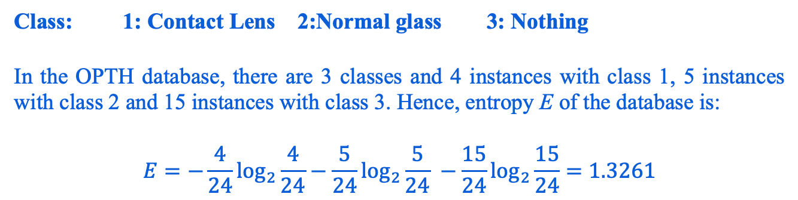
Entropy of a training set
Specification of the attributes are as follows.
Age | Eye Sight | Astigmatic | Use Type
1: Young | 1: Myopia | 1: No | 1: Frequent
2: Middle-aged | 2: Hypermetropia | 2: Yes | 2: Less
3: Old
Class: 1: Contact Lens 2:Normal glass 3: Nothing
In the OPTH database, there are 3 classes and 4 instances with class 1, 5 instances with class 2 and 15 instances with class 3. Hence, entropy E of the database is:
$$E=−\frac{4}{24}\log_{2}{\frac{4}{24}}−\frac{5}{24}\log_{2}{\frac{5}{24}} −\frac{15}{24}\log_{2}{\frac{15}{24}=1.3261}$$

Slide 31
Note:
The entropy of a training set implies the number of yes/no questions, on the average, needed to determine an unknown test to be classified.
It is very crucial to decide the series of questions about the value of a set of attribute, which collectively determine the classification. Sometimes it may take one question, sometimes many more.
Decision tree induction helps us to ask such a series of questions. In other words, we can utilize entropy concept to build a better decision tree.
How entropy can be used to build a decision tree ?

Slide 32
Decision Tree Induction Techniques
Decision tree induction is a top-down, recursive and divide-and-conquer approach.
The procedure is to choose an attribute and split it into from a larger training set into smaller training sets.
Different algorithms have been proposed to take a good control over
Choosing the best attribute to be splitted, and
Splitting criteria
Several algorithms have been proposed for the above tasks. In this lecture, we shall limit our discussions into three important of them
ID3
C 4.5
CART

Slide 33
Algorithm ID3

Slide 34
ID3: Decision Tree Induction Algorithms
Quinlan [1984] introduced the ID3, a popular short form of Iterative Dichotomizer 3 for decision trees from a set of training data.
In ID3, each node corresponds to a splitting attribute and each arc is a possible value of that attribute.
At each node, the splitting attribute is selected to be the most informative among the attributes not yet considered in the path starting from the root.

Slide 35
Algorithm ID3
In ID3, entropy is used to measure how informative a node is.
It is observed that splitting on any attribute has the property that average entropy of the resulting training subsets will be less than or equal to that of the previous training set.
ID3 algorithm defines a measurement of a splitting called Information Gain to determine the goodness of a split.
The attribute with the largest value of information gain is chosen as the splitting attribute and
it partitions into a number of smaller training sets based on the distinct values of attribute under split.

Slide 36
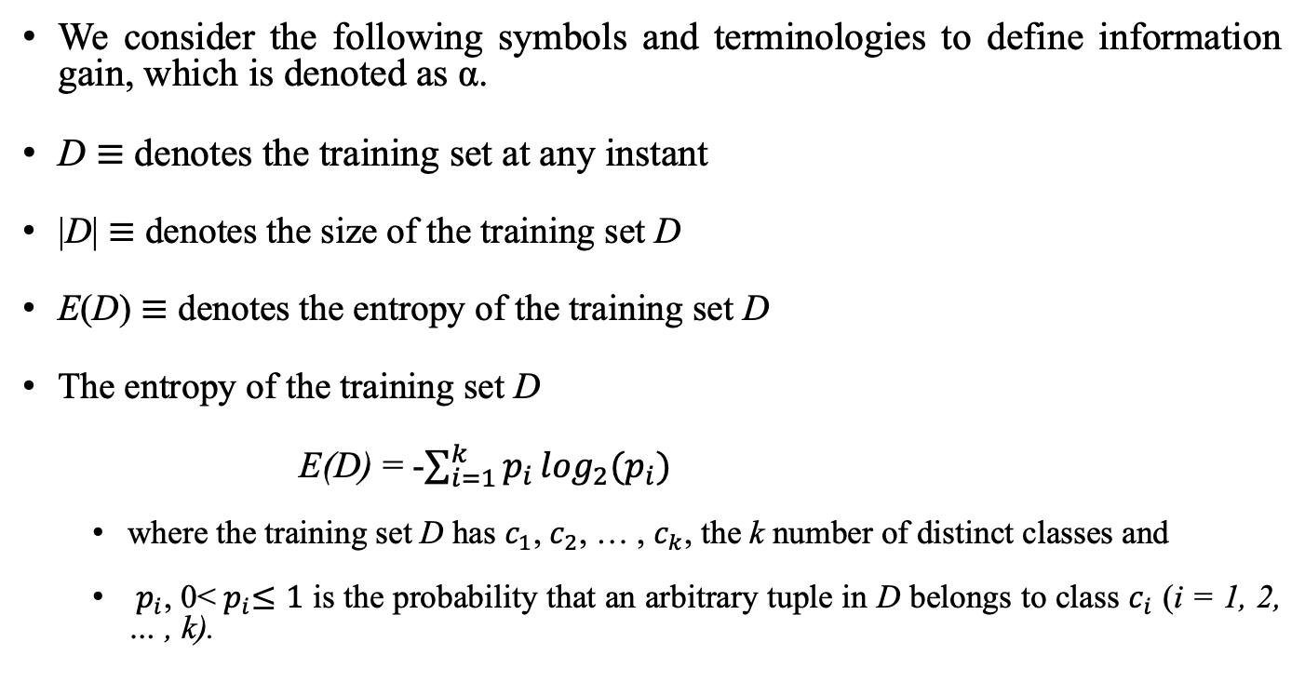
Defining Information Gain
We consider the following symbols and terminologies to define information gain, which is denoted as α.
D $≡$ denotes the training set at any instant
|D| $≡$ denotes the size of the training set D
E(D) $≡$ denotes the entropy of the training set D
The entropy of the training set D
E(D) = -$\sum_{i=1}^{k}{p_{i}}\log_{2}(p_{i})$
where the training set D has $c_{1}$, $c_{2}$, … , $c_{k}$, the k number of distinct classes and
$p_{i}$, 0<${ p}_{i}≤1$ is the probability that an arbitrary tuple in D belongs to class $c_{i}$ (i = 1, 2, … , k).

Slide 37
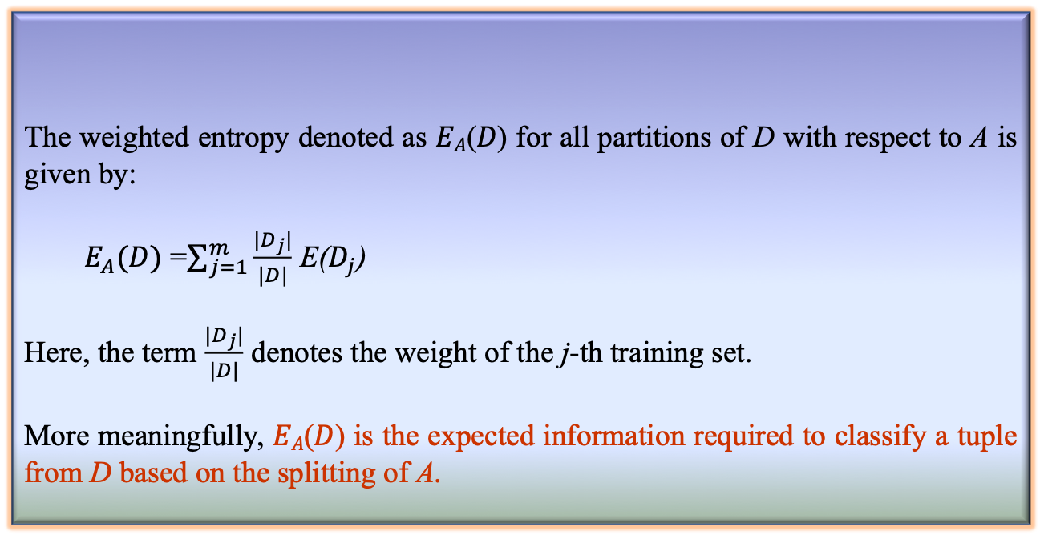
Defining Information Gain
Definition 2: Weighted Entropy
The weighted entropy denoted as 𝐸_{𝐴}(𝐷) for all partitions of D with respect to A is given by:
$E_{A}(D)$ =$\sum_{j=1}^{m}{\frac{{|D}_{j}|}{|D|}}$ E($D_{j}$)
Here, the term $\frac{{|D}_{j}|}{|D|}$ denotes the weight of the j-th training set.
More meaningfully, 𝐸_{𝐴}(𝐷) is the expected information required to classify a tuple from D based on the splitting of A.

Slide 38
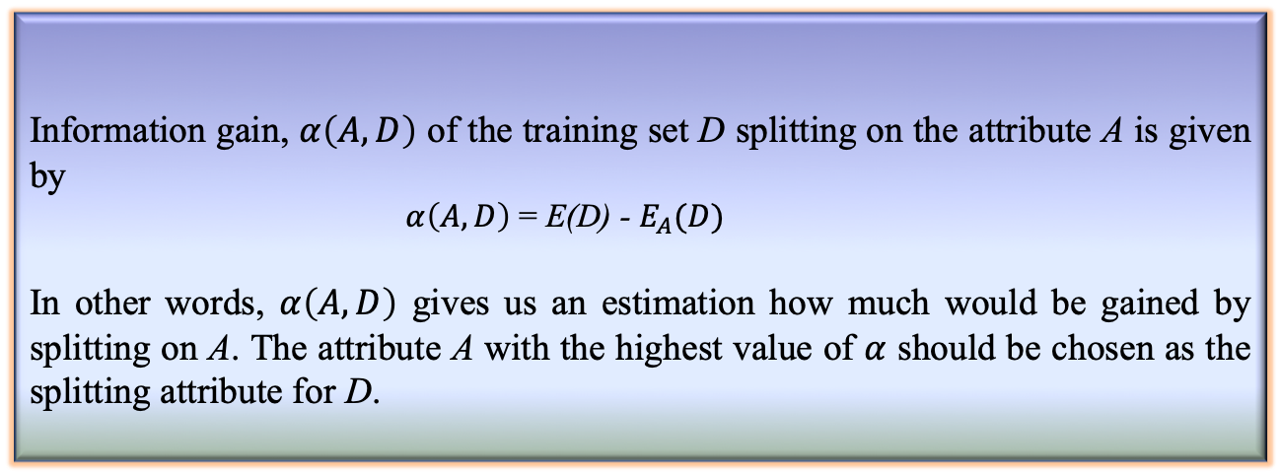
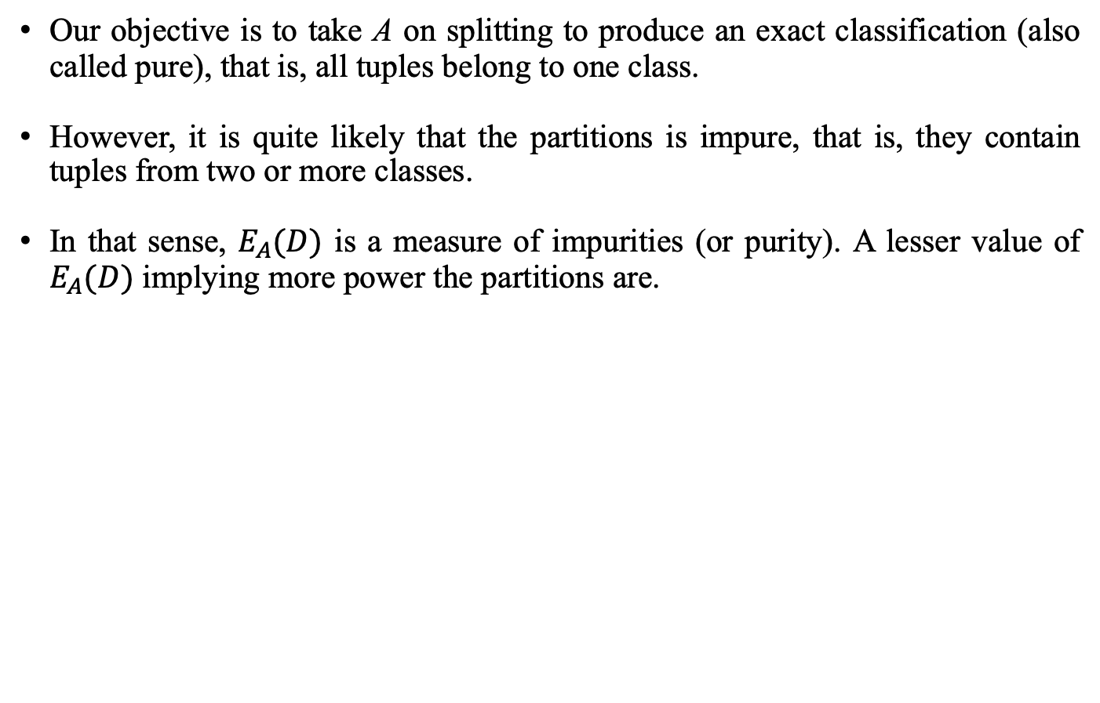
Defining Information Gain
Our objective is to take A on splitting to produce an exact classification (also called pure), that is, all tuples belong to one class.
However, it is quite likely that the partitions is impure, that is, they contain tuples from two or more classes.
In that sense, $E_{A}(D)$ is a measure of impurities (or purity). A lesser value of $E_{A}(D)$ implying more power the partitions are.
Information gain, $α\left(A,D\right)$ of the training set D splitting on the attribute A is given by
$α\left(A,D\right)$ = E(D) - $E_{A}(D)$
In other words, $α\left(A,D\right)$ gives us an estimation how much would be gained by splitting on A. The attribute A with the highest value of $α$ should be chosen as the splitting attribute for D.
Definition 3: Information Gain

Slide 39
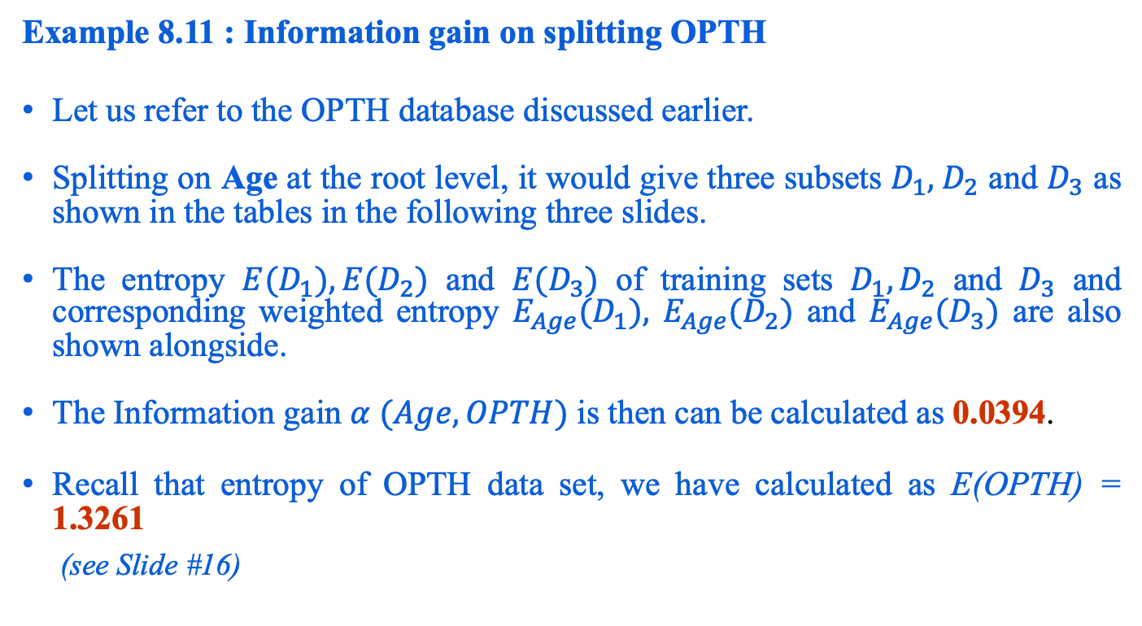
Information Gain Calculation
Example 8.11 : Information gain on splitting OPTH
Let us refer to the OPTH database discussed earlier.
Splitting on Age at the root level, it would give three subsets $D_{1},{ D}_{2}$ and $D_{3}$ as shown in the tables in the following three slides.
The entropy ${E(D}_{1}),{E(D}_{2})$ and ${E(D}_{3})$ of training sets $D_{1},D_{2}$ and $D_{3}$ and corresponding weighted entropy $E_{Age}{(D}_{1}),$ $E_{Age}{(D}_{2})$ and $E_{Age}{(D}_{3})$ are also shown alongside.
The Information gain $α (Age, OPTH)$ is then can be calculated as 0.0394.
Recall that entropy of OPTH data set, we have calculated as E(OPTH) = 1.3261
(see Slide #16)

Slide 40
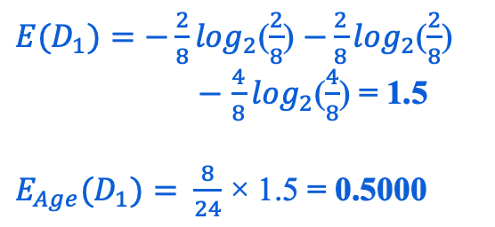
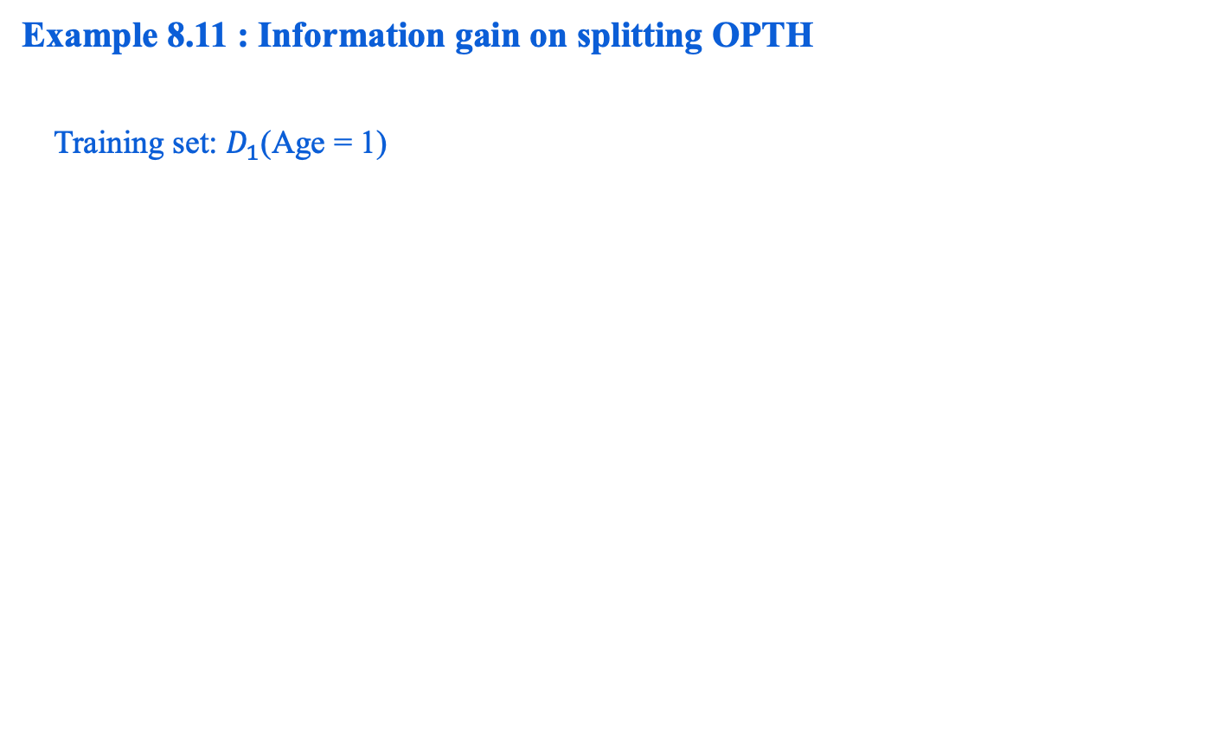
Information Gain Calculation
Example 8.11 : Information gain on splitting OPTH
Training set: $D_{1}$(Age = 1)
Age | Eye-sight | Astigmatism | Use type | Class
1 | 1 | 1 | 1 | 3
1 | 1 | 1 | 2 | 2
1 | 1 | 2 | 1 | 3
1 | 1 | 2 | 2 | 1
1 | 2 | 1 | 1 | 3
1 | 2 | 1 | 2 | 2
1 | 2 | 2 | 1 | 3
1 | 2 | 2 | 2 | 1
${E(D}_{1})=−\frac{2}{8}\log_{2}$($\frac{2}{8}$) $−\frac{2}{8}\log_{2}$($\frac{2}{8}$)
$−$ $\frac{4}{8}\log_{2}$($\frac{4}{8}$) = 1.5
$E_{Age}{(D}_{1})=$ $\frac{8}{24}$ × 1.5 = 0.5000

Slide 41
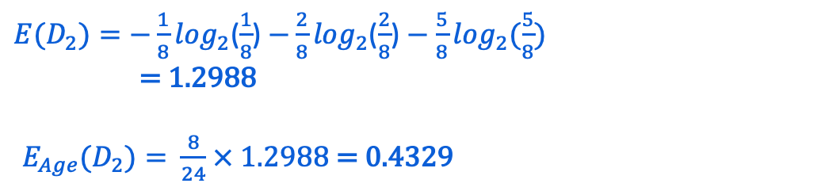
Calculating Information Gain
Training set: $D_{2}$(Age = 2)
Age | Eye-sight | Astigmatism | Use type | Class
2 | 1 | 1 | 1 | 3
2 | 1 | 1 | 2 | 2
2 | 1 | 2 | 1 | 3
2 | 1 | 2 | 2 | 1
2 | 2 | 1 | 1 | 3
2 | 2 | 1 | 2 | 2
2 | 2 | 2 | 1 | 3
2 | 2 | 2 | 2 | 3
${E(D}_{2})=−\frac{1}{8}\log_{2}$($\frac{1}{8}$) $−\frac{2}{8}\log_{2}$($\frac{2}{8}$) $−$ $\frac{5}{8}\log_{2}$($\frac{5}{8}$)
= 1.2988
$E_{Age}{(D}_{2})=$ $\frac{8}{24}$ × 1.2988 = 0.4329

Slide 42
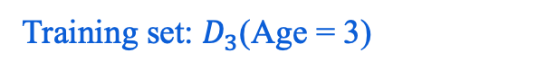
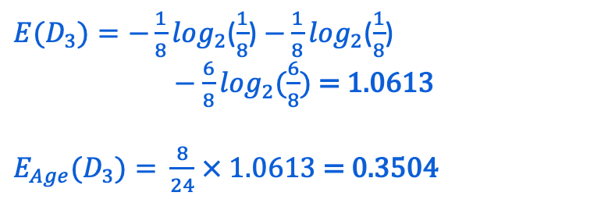
Calculating Information Gain
Training set: $D_{3}$(Age = 3)
Age | Eye-sight | Astigmatism | Use type | Class
3 | 1 | 1 | 1 | 3
3 | 1 | 1 | 2 | 3
3 | 1 | 2 | 1 | 3
3 | 1 | 2 | 2 | 1
3 | 2 | 1 | 1 | 3
3 | 2 | 1 | 2 | 2
3 | 2 | 2 | 1 | 3
3 | 2 | 2 | 2 | 3
${E(D}_{3})=−\frac{1}{8}\log_{2}$($\frac{1}{8}$) $−\frac{1}{8}\log_{2}$($\frac{1}{8}$)
$−$ $\frac{6}{8}\log_{2}$($\frac{6}{8}$) = 1.0613
$E_{Age}{(D}_{3})=$ $\frac{8}{24}$ × 1.0613 = 0.3504
$α (Age, D)$ = 1.3261 – (0.5000 + 0.4329 + 0.3504) = 0.0394

Slide 43
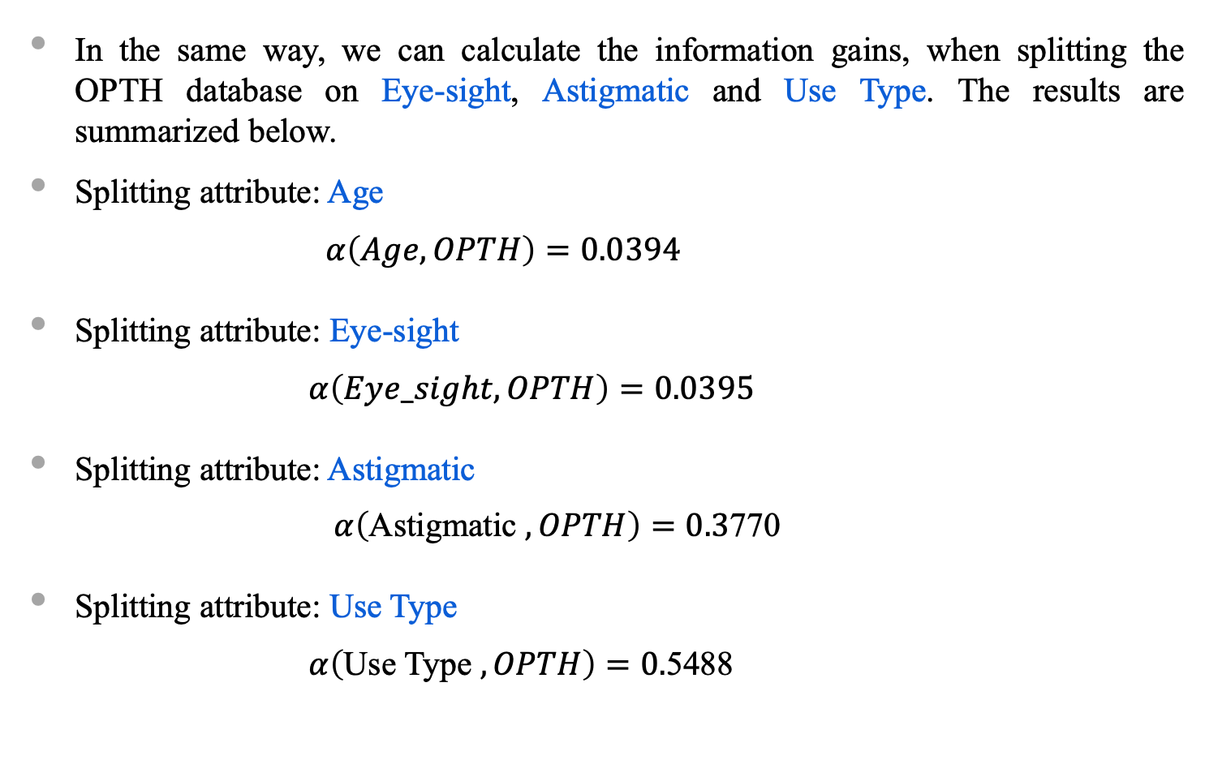
Information Gains for Different Attributes
In the same way, we can calculate the information gains, when splitting the OPTH database on Eye-sight, Astigmatic and Use Type. The results are summarized below.
Splitting attribute: Age
$$α\left(Age, OPTH\right)=0.0394$$
Splitting attribute: Eye-sight
$α\left(Eye_sight, OPTH\right)=0.0395$
Splitting attribute: Astigmatic
$α\left(\text{Astigmatic} , OPTH\right)=0.3$770
Splitting attribute: Use Type
$α\left(\text{Use} \text{Type} , OPTH\right)=0.$5488

Slide 44
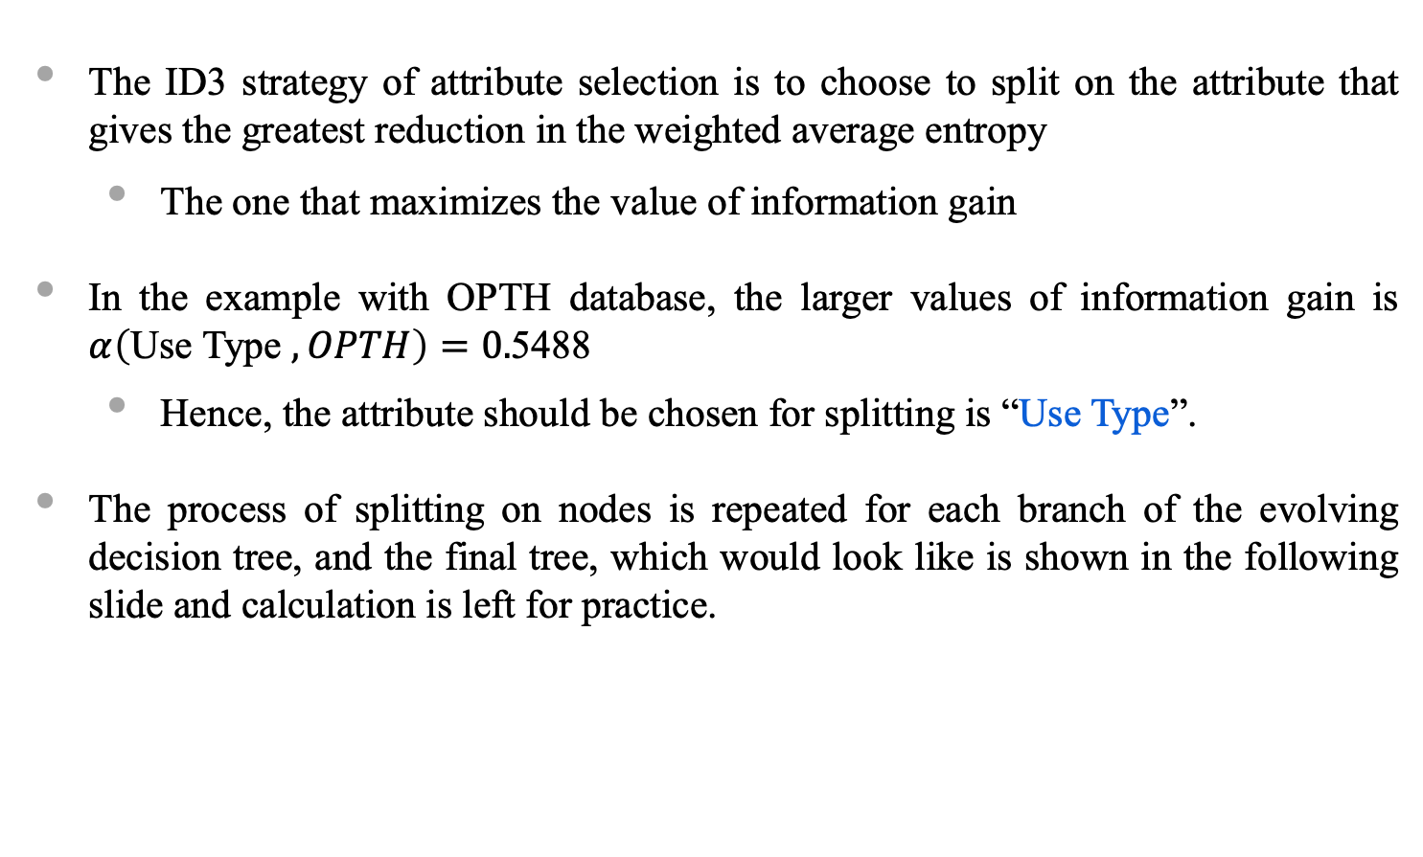
Decision Tree Induction : ID3 Way
The ID3 strategy of attribute selection is to choose to split on the attribute that gives the greatest reduction in the weighted average entropy
The one that maximizes the value of information gain
In the example with OPTH database, the larger values of information gain is $α\left(\text{Use} \text{Type} , OPTH\right)=0.$5488
Hence, the attribute should be chosen for splitting is “Use Type”.
The process of splitting on nodes is repeated for each branch of the evolving decision tree, and the final tree, which would look like is shown in the following slide and calculation is left for practice.

Slide 45
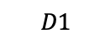
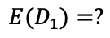

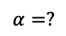

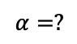
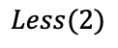
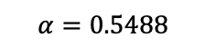
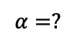

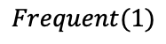
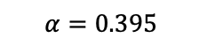
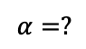

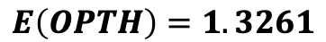
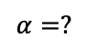
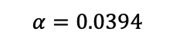
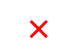
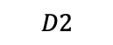



Decision Tree Induction : ID3 Way
$$E\left(OPTH\right)=1.3261$$
$$OPTH$$
$$×$$
$$×$$
✓
$$×$$
Age
Eye-sight
Use Type
Astigmatic
$$α=0.0394$$
$$α=0.395$$
$$α=0.5488$$
$$α=0.3770$$
$$D1$$
$$Frequent(1)$$
$$D2$$
$$Less(2)$$
Age | Eye | Ast | Use | Class
1 | 1 | 1 | 1 | 3
1 | 1 | 2 | 1 | 3
1 | 2 | 1 | 1 | 3
1 | 2 | 2 | 1 | 3
2 | 1 | 1 | 1 | 3
2 | 2 | 1 | 1 | 3
2 | 2 | 2 | 1 | 3
3 | 1 | 1 | 1 | 3
3 | 1 | 2 | 1 | 3
3 | 2 | 1 | 1 | 3
3 | 2 | 2 | 1 | 3
Age | Eye | Ast | Use | Class
1 | 1 | 1 | 2 | 2
1 | 1 | 2 | 2 | 1
1 | 2 | 1 | 2 | 2
1 | 2 | 2 | 2 | 1
2 | 1 | 1 | 2 | 2
2 | 1 | 2 | 2 | 1
2 | 2 | 1 | 2 | 2
3 | 1 | 1 | 2 | 3
3 | 1 | 2 | 2 | 3
3 | 2 | 1 | 2 | 2
3 | 2 | 2 | 2 | 3
$${E(D}_{1})=?$$
$${E(D}_{2})=?$$
$$?$$
$$?$$
$$?$$
$$?$$
$$?$$
$$?$$
Age
Eye-sight
Astigmatic
Age
Eye-sight
Astigmatic
$$α=?$$
$$α=?$$
$$α=?$$
$$α=?$$
$$α=?$$
$$α=?$$

Slide 46

Frequency Table : Calculating α
Calculation of entropy for each table and hence information gain for a particular split appears tedious (at least manually)!
As an alternative, we discuss a short-cut method of doing the same using a special data structure called Frequency Table.
Frequency Table: Suppose, $X=\{x_{1},{ x}_{2},…, x_{n}\}$ denotes an attribute with $n−different$ attribute values in it. For a given database $D$, there are a set of $k classes$say $C=\{c_{1},c_{2},…c_{k}\}$. Given this, a frequency table will look like as follows.

Slide 47



Frequency Table : Calculating α
$$X$$
 | $$x_{1}$$ | $$x_{2}$$ |  | $$x_{i}$$ |  | $$x_{n}$$
$$c_{1}$$
$$c_{2}$$
$$c_{j}$$ |  |  |  | $$f_{ij}$$
$$c_{k}$$
Number of rows = Number of classes
Number of columns = Number of attribute values
$f_{ij}$ = Frequency of $x_{i}$ for class $c_{j}$
Class
Assume that $\left|D\right|=N$, the number of total instances of $D$.

Slide 48
Calculation of α using Frequency Table
Example 8.12 : OTPH Dataset
With reference to OPTH dataset, and for the attribute Age, the frequency table would look like
Column Sums
 | Age=1 | Age=2 | Age=3 | Row Sum
Class 1 | 2 | 1 | 1 | 4
Class 2 | 2 | 2 | 1 | 5
Class 3 | 4 | 5 | 6 | 15
Column Sum | 8 | 8 | 8 | 24
N=24

Slide 49

Calculation of α using Frequency Table
The weighted average entropy $E_{X}(D)$ then can be calculated from the frequency table following the
Calculate $V=f_{ij}\log_{2}{f_{ij}}$ for all $i=1,2,…, k$
(Entry Sum) $j=1, 2,…, n$ and $v_{ij}≠0$
Calculate $S=s_{i}\log_{2}{s_{i}}$ for all $i=1, 2,…,n$
(Column Sum) in the row of column sum
Calculate $E_{X}\left(D\right)=(−V+S)/N$
Example 8.13: OTPH Dataset
For the frequency table in Example 18.12, we have
$$V=2\log{2 }+1\log{1 }+1\log{1 }+2\log{2 }+2\log{2 }+1\log{1 }+4\log{4 }+5\log{5 }+6\log{6 }$$
$S=8\log{8 }+8\log{8 }+8\log{8 }$
$E_{Age}\left(OPTH\right)=1.2867$

Slide 50

Limiting Values of Information Gain
The Information gain metric used in ID3 always should be positive or zero.
It is always positive value because information is always gained (i.e., purity is improved) by splitting on an attribute.
On the other hand, when a training set is such that if there are $k$ classes, and the entropy of training set takes the largest value i.e., $\log_{2}{k}$ (this occurs when the classes are balanced), then the information gain will be zero.

Slide 51


Limiting Values of Information Gain
Example 8.14: Limiting values of Information gain
Consider a training set shown below.
Data set Table A X Table X
Y
X | Y | Class
1 | 1 | A
1 | 2 | B
2 | 1 | A
2 | 2 | B
3 | 2 | A
3 | 1 | B
4 | 2 | A
4 | 1 | B
 | 1 | 2 | 3 | 4
A | 1 | 1 | 1 | 1
B | 1 | 1 | 1 | 1
$$C.Sum$$ | 2 | 2 | 2 | 2
Frequency table of X
Y
Table Y
 | 1 | 2
A | 2 | 2
B | 2 | 2
$$C.Sum$$ | 4 | 4
Frequency table of Y

Slide 52

Limiting values of Information Gain
Entropy of Table A is
$E=−\frac{1}{2}\log{\frac{1}{2}−\frac{1}{2}\log{\frac{1}{2}}}=\log{2}=1$ (The maximum entropy).
In this example, whichever attribute is chosen for splitting, each of the branches will also be balanced thus each with maximum entropy.
In other words, information gain in both cases (i.e., splitting on X as well as Y) will be zero.
Note:
The absence of information gain does not imply that there is no profit for splitting on the attribute.
Even if it is chosen for splitting, ultimately it will lead to a final decision tree with the branches terminated by a leaf node and thus having an entropy of zero.
Information gain can never be a negative value.

Slide 53
Reference
The detail material related to this lecture can be found in
Data Mining: Concepts and Techniques, (3rd Edn.), Jiawei Han, Micheline Kamber, Morgan Kaufmann, 2015.
Introduction to Data Mining, Pang-Ning Tan, Michael Steinbach, and Vipin Kumar, Addison-Wesley, 2014

Slide 54
Any question?

